Slide 1
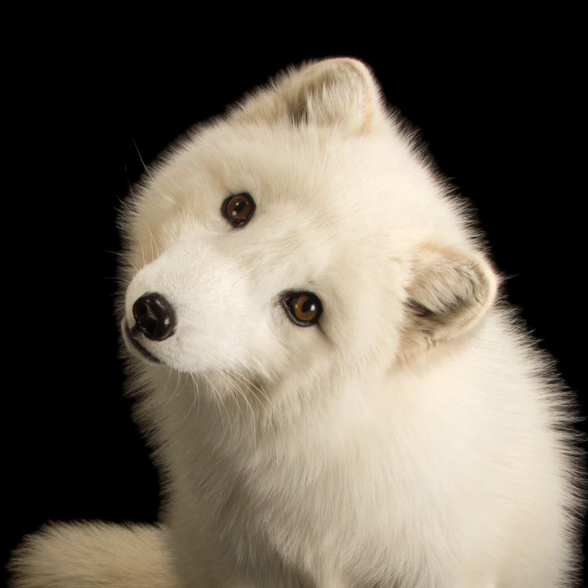
Arctic FOXes by eIIEN MAI
Arctic foxes can have 25 babies but only 5 or 8 can survive.

