Slide 1
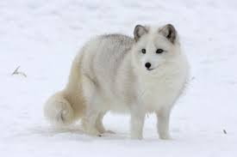
ARCTIC FOX by Molly rose
An Arctic fox eats lemmings.

