Slide 1
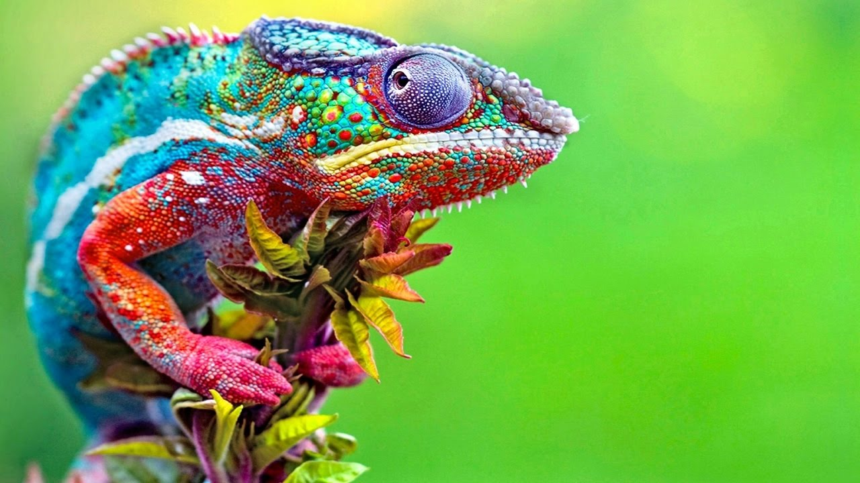
CHAMELEON
Chameleons have long tongues.
They eat flies.
They can camouflage.
By Adam Grew p3

