Slide 1
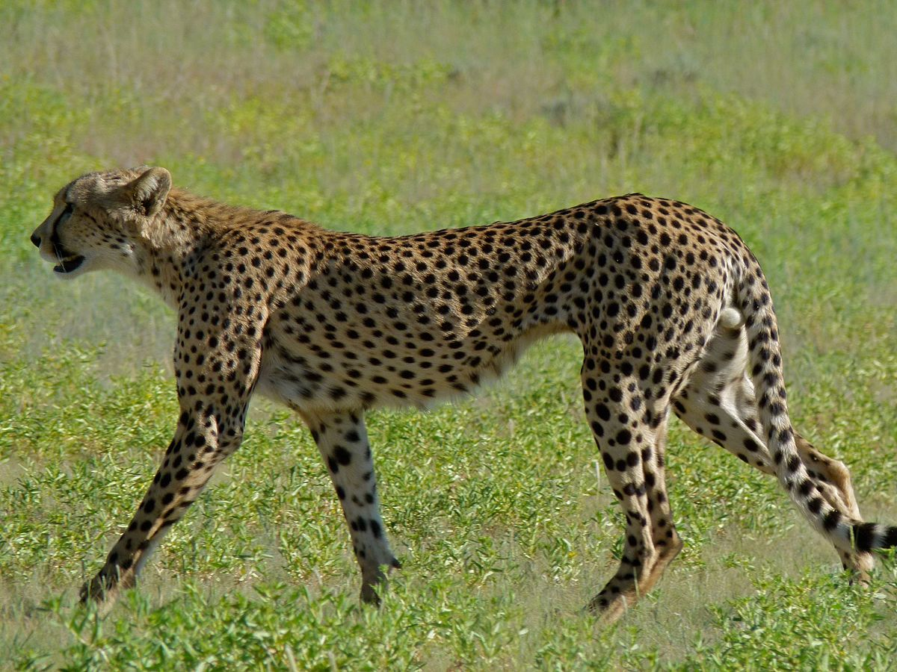
CHEETAh

Slide 2
FactS
The cheetah is the fastest wild cat.
The cheetah has black spots.
By Sophie Duggan P3.

