Slide 1
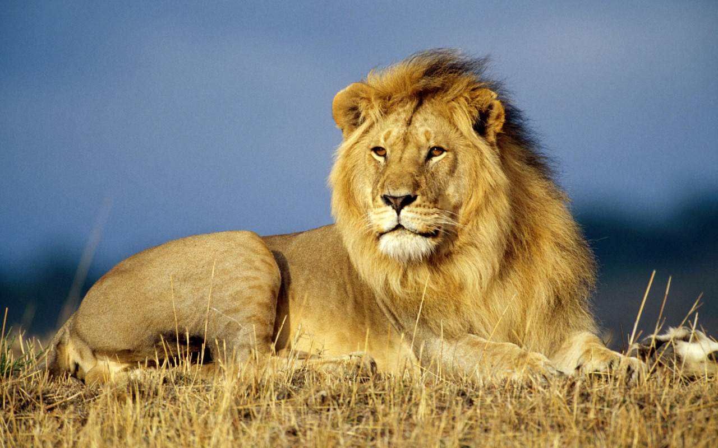
Lioo Lions Lions like to hunt. By Dara

