Slide 1
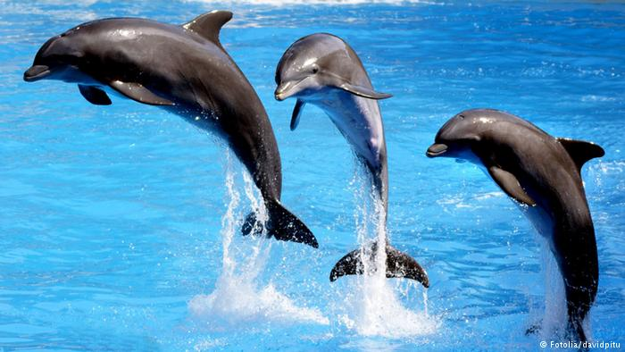
dolphins

Slide 2
Facts:
Dolphins are mammals and can be found in oceans.
Dolphins do not drink any water because it is salt water.
Some dolphins have 250 teeth and some have 8 teeth.
Dolphins are friendly.

Slide 3
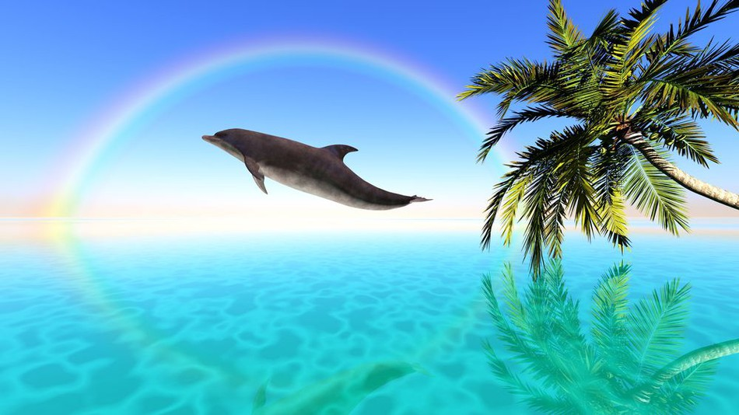

Slide 4
By Niamh p3

