Slide 1
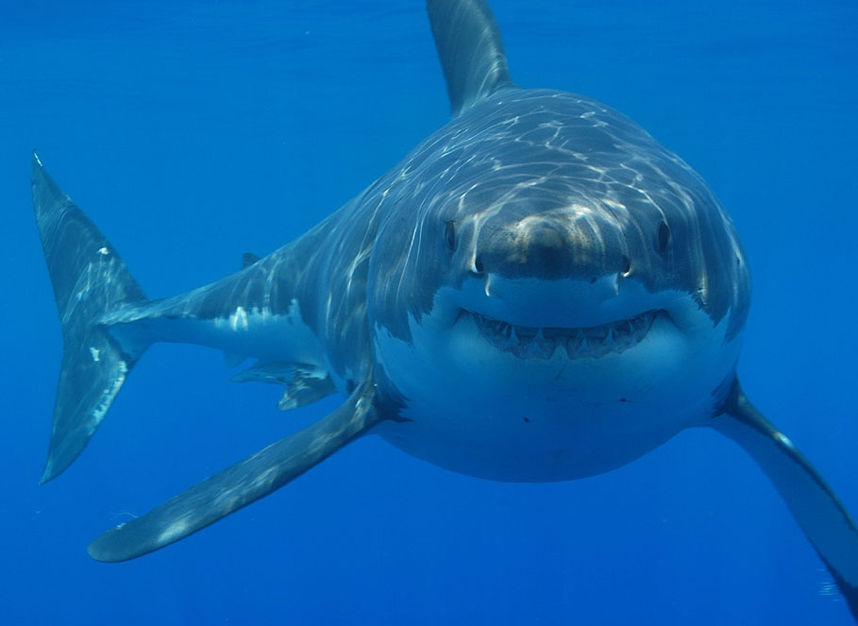
Sharks Sharks live in the water and they eat fish. By Edi

