Slide 1
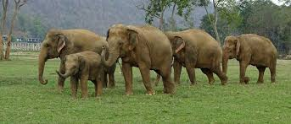
ELEPHANTS
Elephants have long trunks.
THEY SQUIRT WATER OVER THEMSELVES.
BY annie p3

