Slide 1
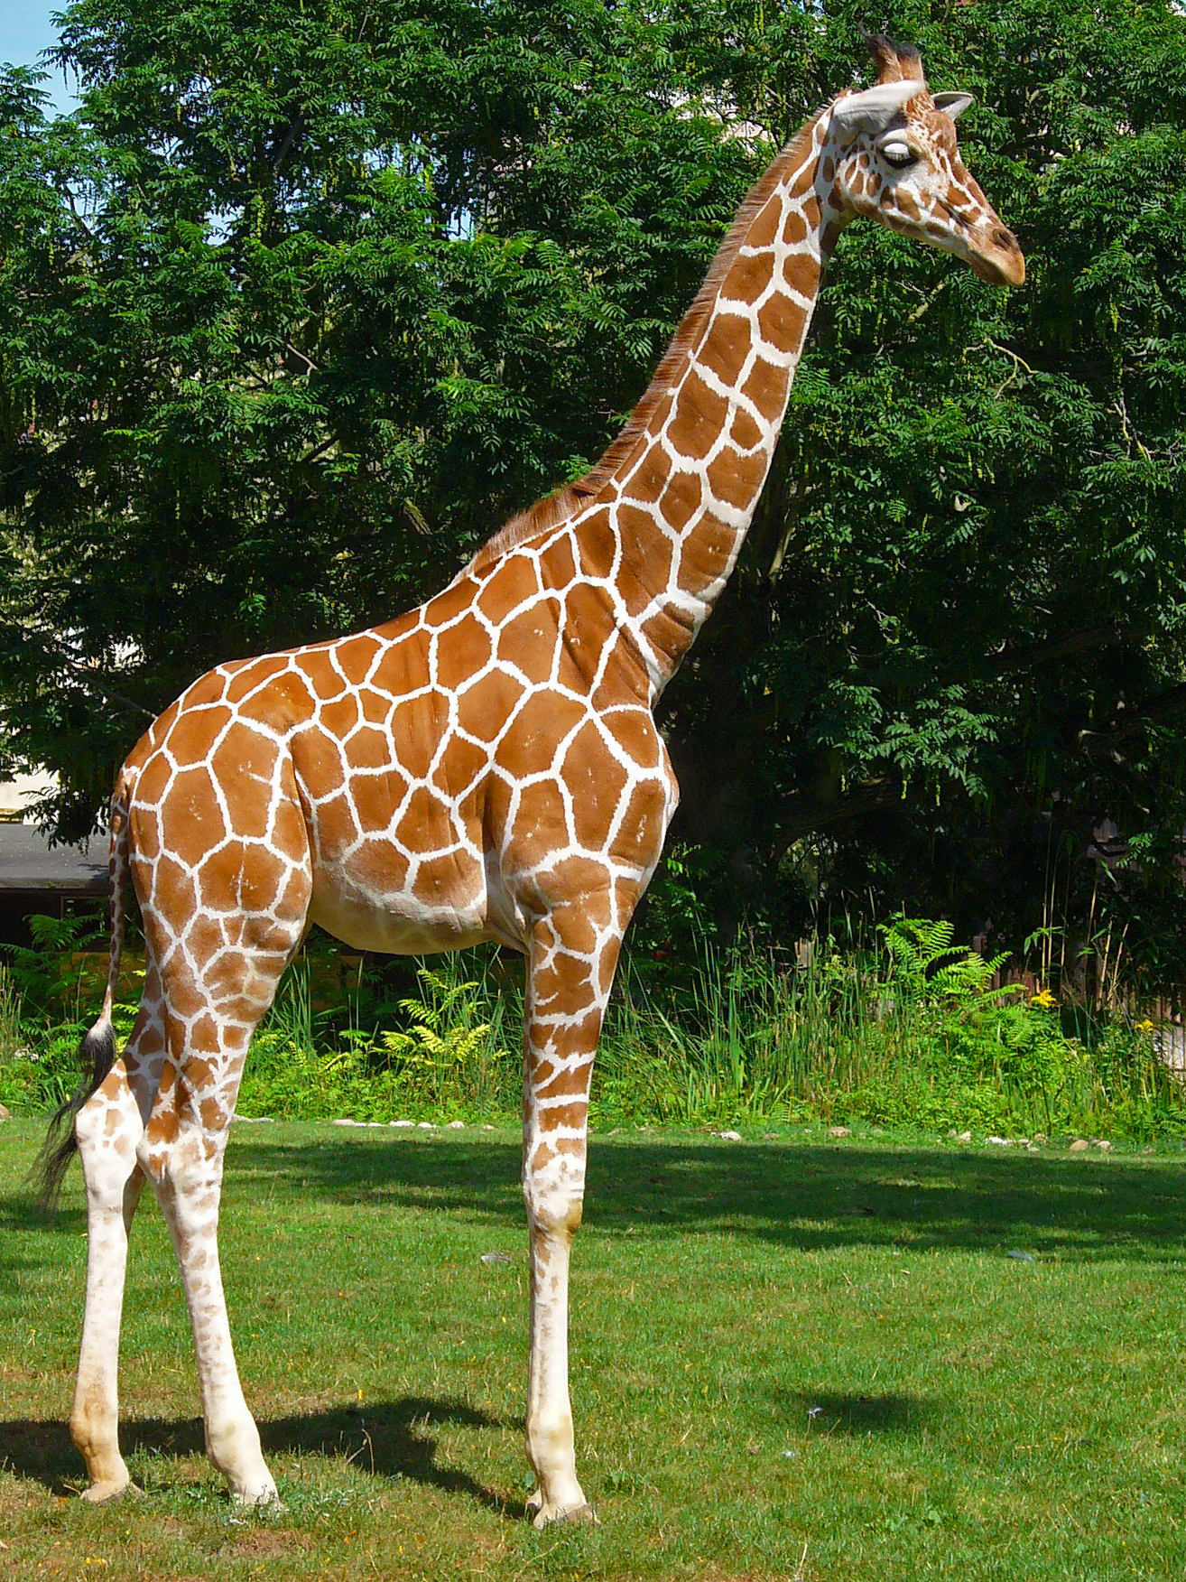
Giraffe A giraffe is the tallest land animal in the world. By Amelia Barry

