Slide 1
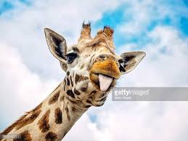
GIRAFFES BY MEGAN
Giraffes have long necks.
THEY HAVE BLACK TONGUES.

