Slide 1
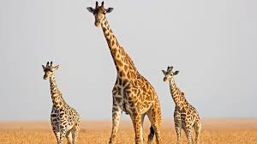
Giraffes are tall.
They have long necks.
By Portia

