Slide 1
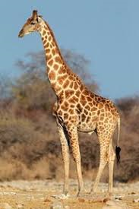
Giraffes By Shane. P3
Giraffes have long necks.

