Slide 1
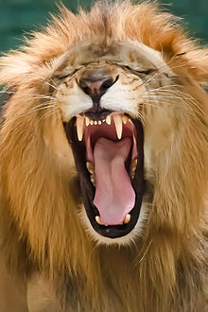
LIONS by Adam J
Lions have big roars.

