Slide 1
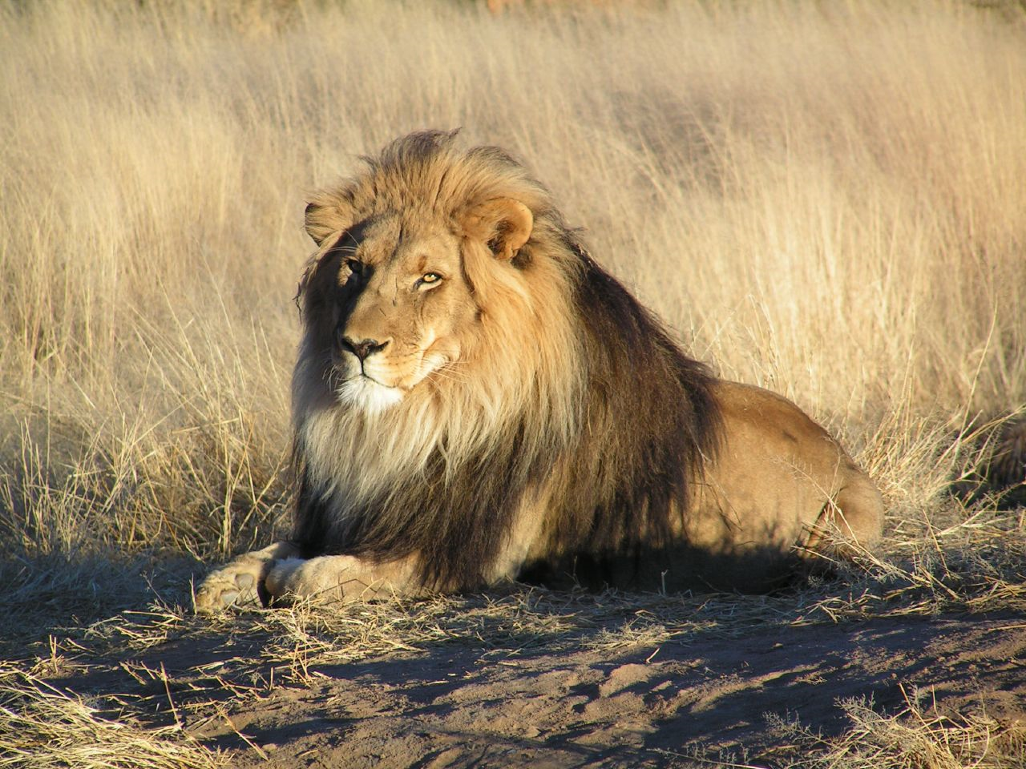
Lions
Lions live in Africa.
By Shay. p2

