Slide 1
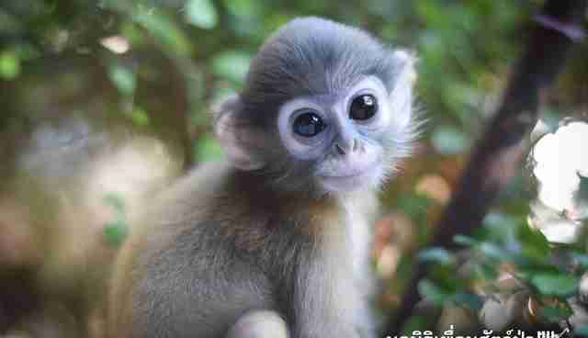
MONKEYS

Slide 2
Facts:
There are 264 different types of monkeys.
You can find monkeys in the zoo.
Spider monkeys have their name because they have long legs and arms.
Monkeys eat bananas.
Monkeys can live under ground or on the ground or in trees.
Monkeys are really playful and they like to hug each other.
Monkeys have lots of hair. By Elsie Cusack P3

