Slide 1
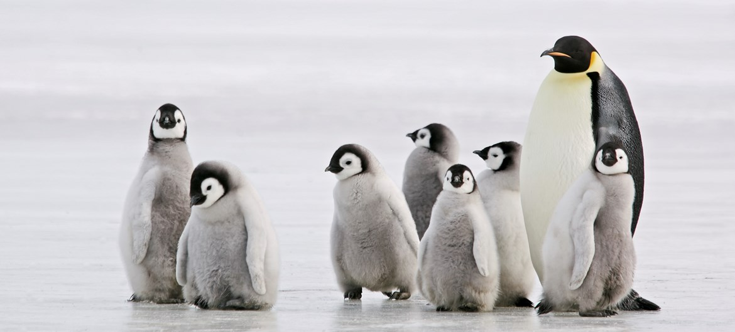
PeNGUINS
Penguins eat Krill and tiny fish.
They live in Antarctica. By Charlie

