Slide 1
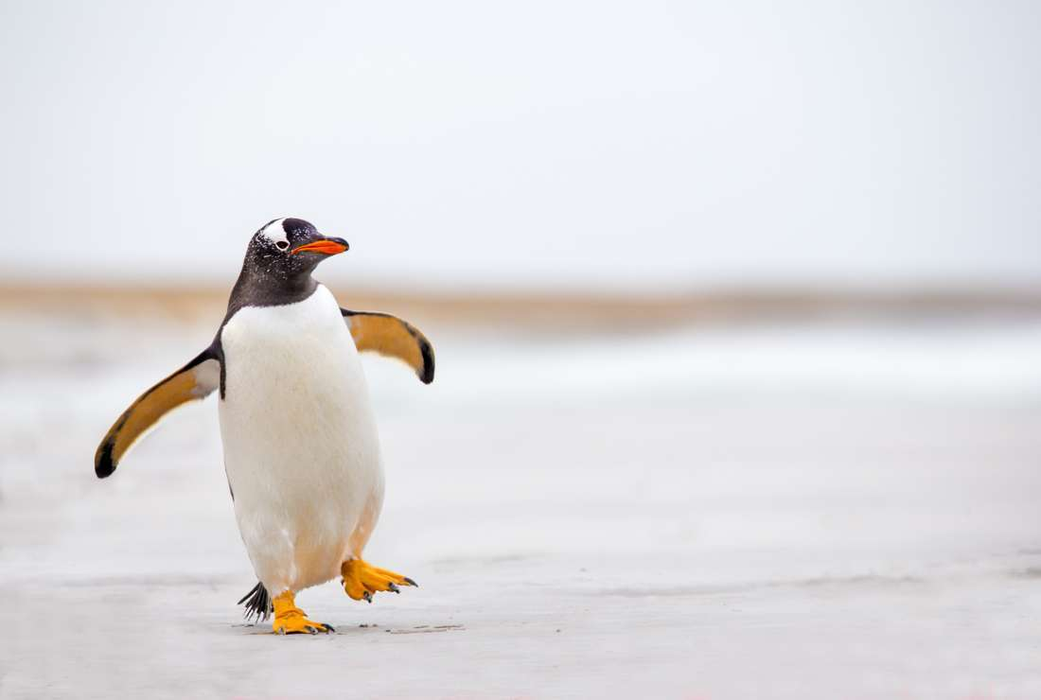
penguins

Slide 2
THE emperor Penguin is the biggest penguin.
Fact

Slide 3
If the females baby dies she will kidnap another penguins baby. The smallest penguin is the blue penguin.
Facts

Slide 4
By Hannah Magill P3

