Slide 1
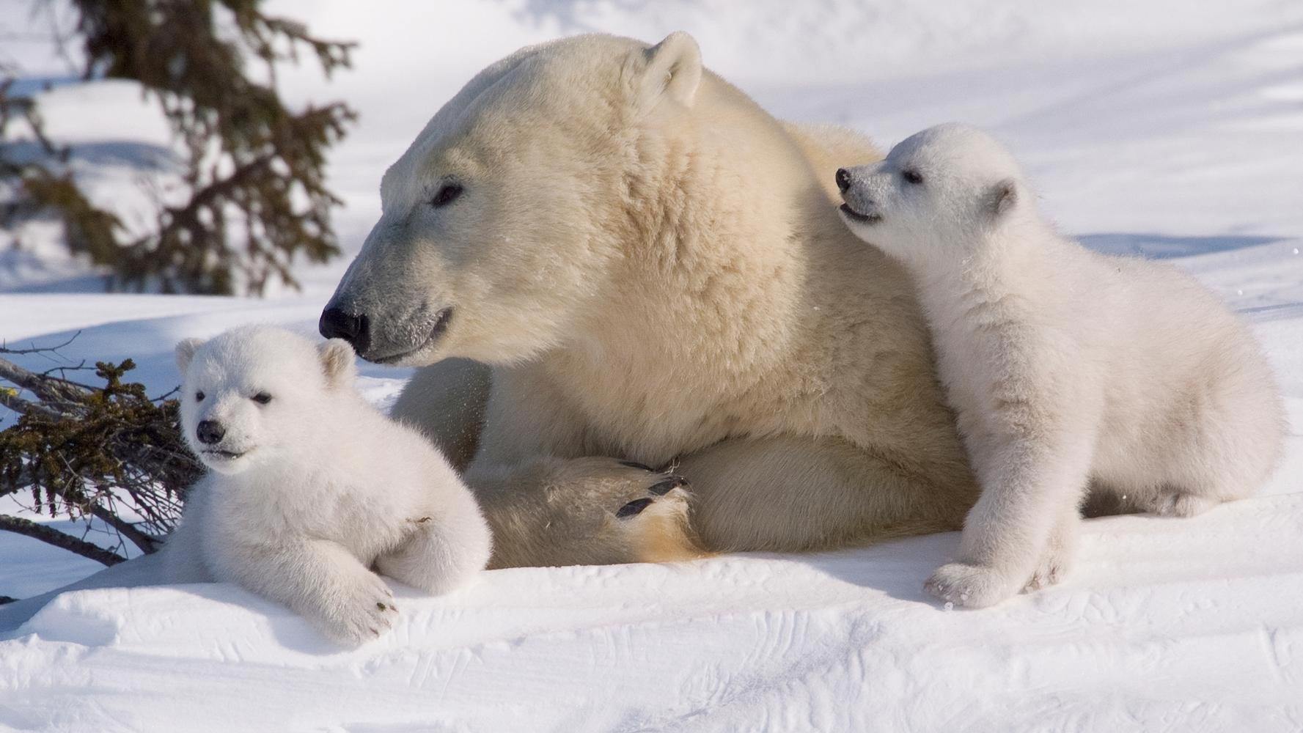
POLAR BEARS
Polar bears live in the Arctic.
By Isla Gaffney P2

