Slide 1
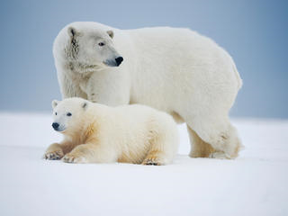
Polar bears by aoife
They have white fur.

