Slide 1
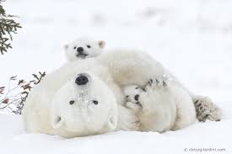
POLAR BEARS
They live in the Arctic.
By Katie Rose

