Slide 1
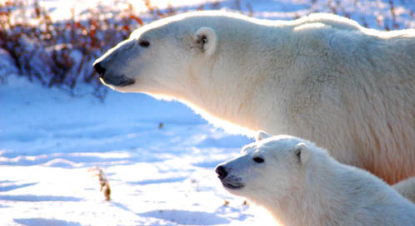
Polar bears
Polar bear babies are called cubs.
By Maisie
P2

