Slide 1
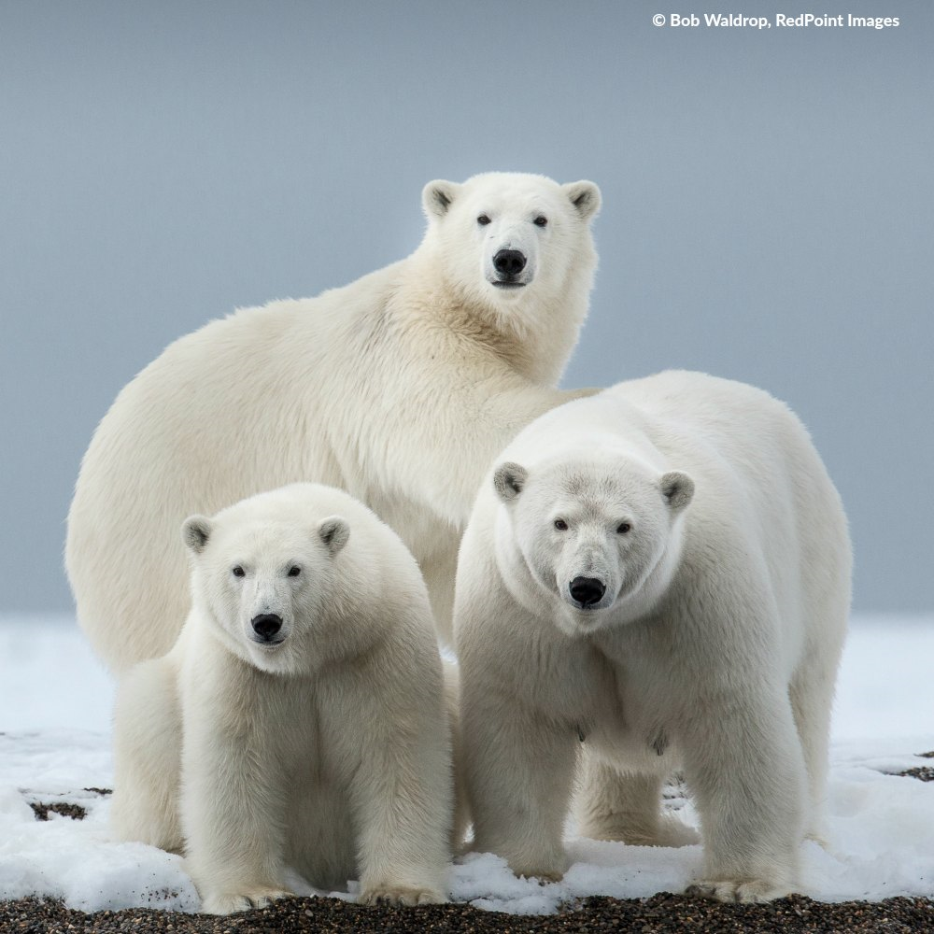
POLAR bears live in the arctic. polar bears have thick fur. All polar bears are LEFT HANDED.
Polar bears
By Niamh Connolly

