Slide 1
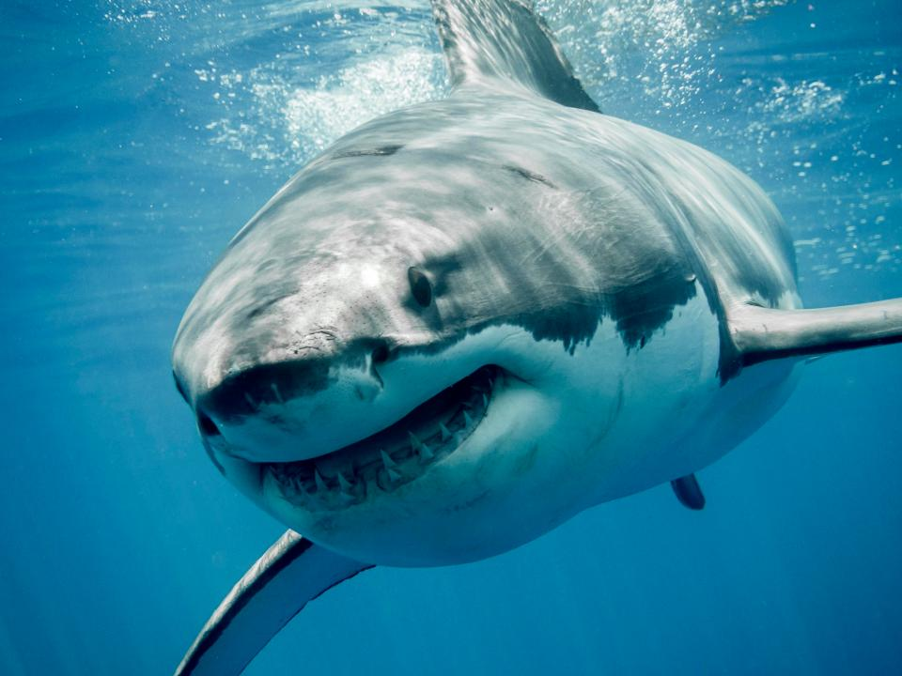
SHARKS
Sharks live in water.
Sharks like to eat fish.
By Daniel P3

