Slide 1
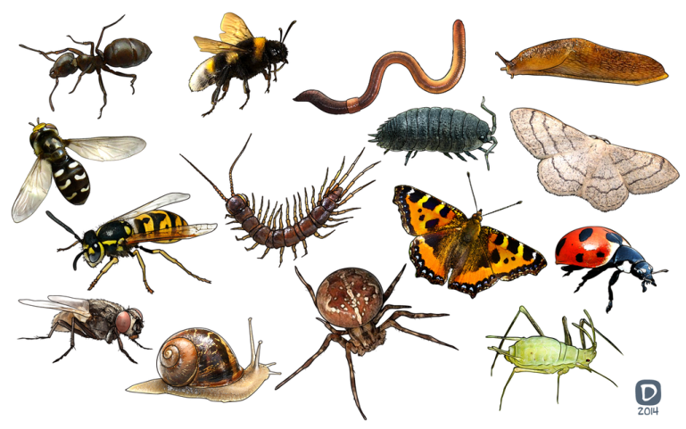
MINI-BEASTS
BY
PRIMARY TW0

Slide 2
CONTENTS
Ladybirds
Butterflies
Ants
Caterpillars
Dragonflies
Wasps

Slide 3
Ladybirds
Ladybirds are tiny and delicate creatures.
A ladybird has black spots and has a red shell on top.
Ladybirds eat greenfly.
Ladybirds can lay eggs on a leaf.
During the summer, ladybirds live in shrubs
and flowers.
In the Uk ladybirds like the wild flowers.
A ladybird has two feelers.
A ladybird has wings.
Ladybirds have three body parts.
When hibernating ladybirds huddle together in order to keep warm.

Slide 4
Butterfly
The Queen Alexandra is the biggest butterfly in the world!
Butterflies like to eat leaves, water and nectar.
Butterflies have four wings.

Slide 5
Ants
Ants can pass messages and they can learn.
Ants eat leaves.
Ants live in old wood.
Ants are tiny creatures.

Slide 6
Caterpillars
A caterpillar lives on a leaf.
A caterpillar can camouflage.

Slide 7
Dragonfly
A dragonfly lives near water.
A dragonfly eats midges and mosquitoes.
A dragonfly lays eggs.

Slide 8
Wasp
A wasp lives in a nest.
A wasp can sting.
A wasp is black and yellow.

Slide 9
Glossary
Delicate- easily broken
UK – United Kingdom (N-Ireland, Scotland, Wales and England)
Hibernating- when animals sleep over the Winter
Camouflage- blending into its surroundings

