Slide 1
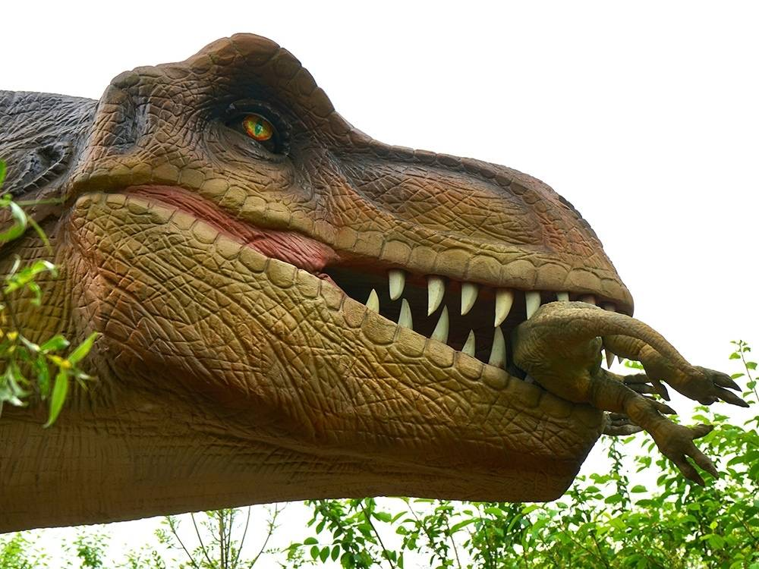
What I know about Dinosaurs ? By Adam

Slide 2
Some dinosaurs ate meat and leaves.

Slide 3
The Tyrannosaurus- Rex had sharp teeth.

Slide 4
The Pterodactyl had wings.

Slide 5
Some dinosaurs had horns.

Slide 6
Dinosaurs laid eggs.

