Slide 1
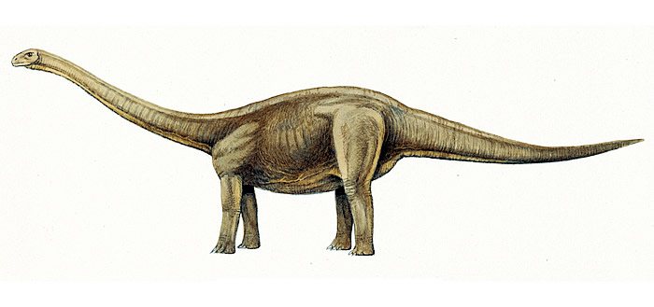
facts
DINOSAURS
by Amelia Barry

Slide 2
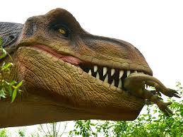
A Stegosaurus had bony plates on its back.
The T- rex had a long tail and short arms. IN THE MUSEUM YOU COULD FIND A SKELETON OF A DINOSAUR. A PTERODACTY HAS A SILENT P IN ITS NAME. Some dinosaurs were herbivores and some were carnivores.

