Slide 1
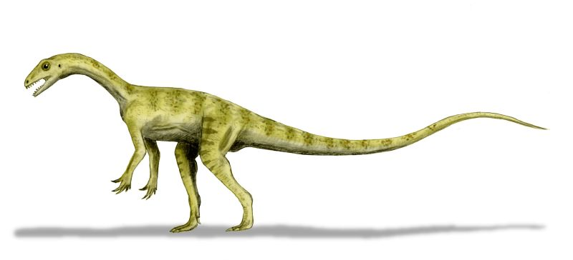
Dinosaurs by Aoibhinn

Slide 2
The T-Rex had a long tail.
Dinosaurs were all different.
Dinosaurs are all extinct.

