Slide 1
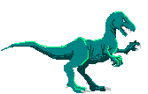
Dinosaurs
Aoife trainor

Slide 2
Stegosaurus
The stegosaurus had bony plates on its back.

Slide 3
Facts
Some dinosaurs had feathers.
Some dinosaurs had long necks.
Some dinosaurs were small.

