Slide 1
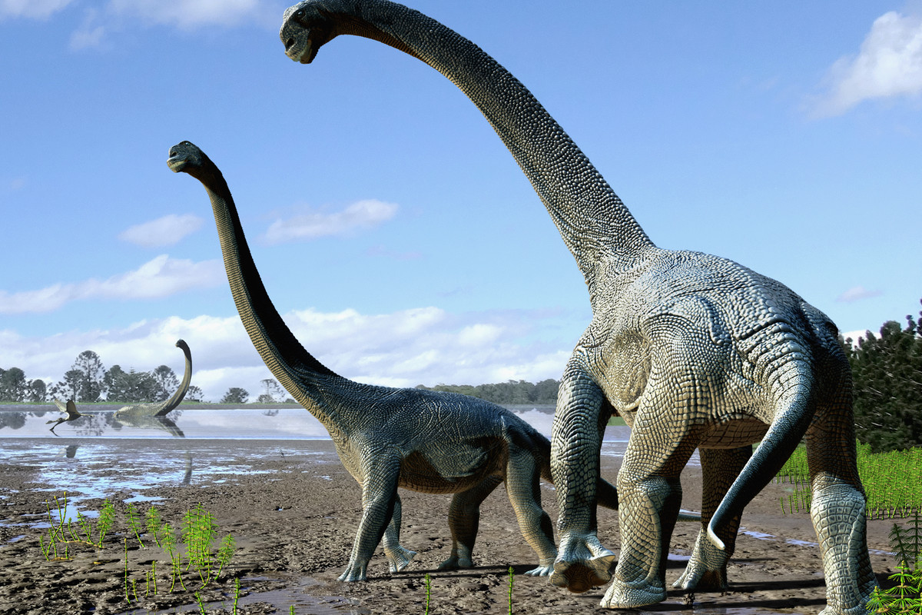
Dinosaurs
by Casey

Slide 2
Some dinosaurs were different sizes.

Slide 3
Some dinosaurs were carnivores.

