Slide 1
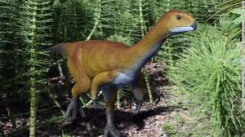
Dinosaurs by Charlotte

Slide 2
The T-Rex had a long tail and short arms.
Dinosaurs are now extinct.

