Slide 1
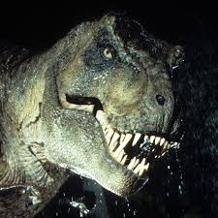
the t-rex was a meat eater. The t-rex was forty metres high. The t-rex haD two short arms and a long tail.
Dinosaurs
By Cormac Gallagher

