Slide 1
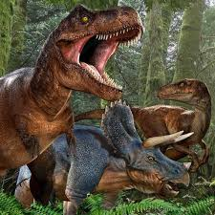
Dinosaurs bY Dara

Slide 2
The stegosaurus had spikes on its back and tail.
The T-Rex had a long tail and short arms.

Slide 3
The T-Rex was a carnivore.

