Slide 1
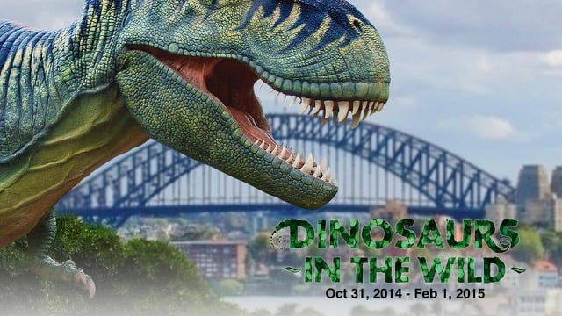
Dinosaurs by Darragh

Slide 2
A T-Rex had very sharp teeth and a long tail.

