Slide 1
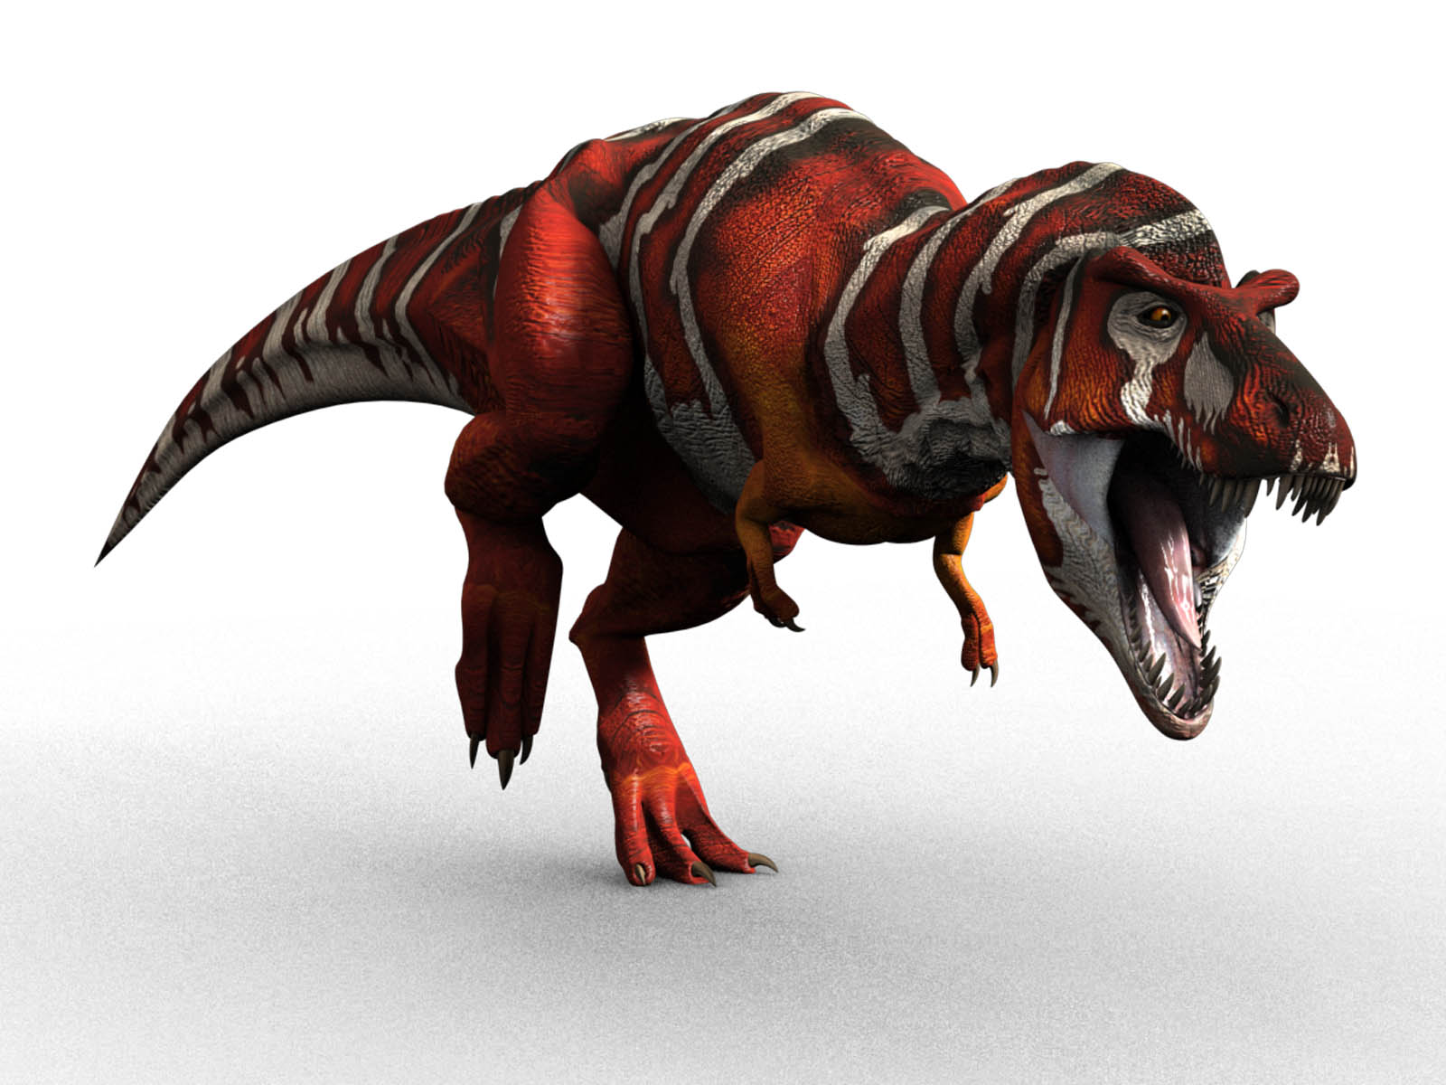
What I know about dinosaurs By Edi

Slide 2
Dinosaurs were all different shapes and sizes.

Slide 3
A T-Rex had sharp teeth.

Slide 4
A T-Rex was the biggest dinosaur.

