Slide 1
Dinosaurs by Ellen Mai
E

Slide 2
There were lots of different dinosaurs.
Dinosaurs laid eggs and then baby dinosaurs hatched.

Slide 3
Some dinosaurs ate meat and some ate plants. They were called herbivores and carnivores. Dinosaurs had lots of teeth.

Slide 4
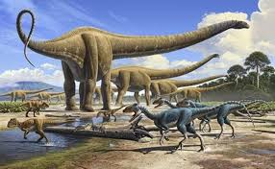
The Pterodactyl has a silent p in its name.

