Slide 1
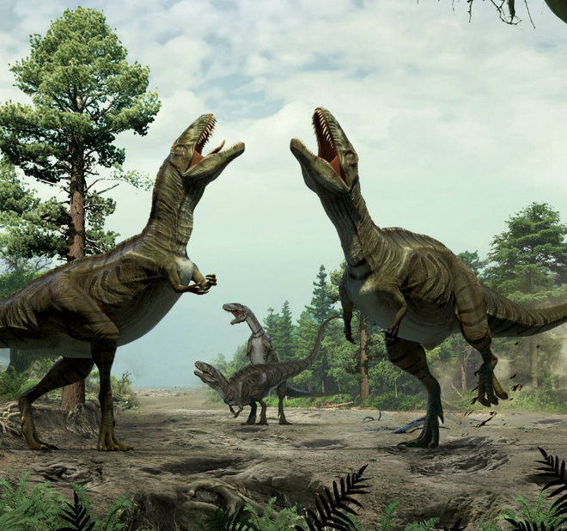
Dinosaurs
By FRANK

Slide 2
A T-Rex was big. A T-Rex had short arms.
Dinosaurs had sharp claws.
Some dinosaurs had long
tails.

