Slide 1
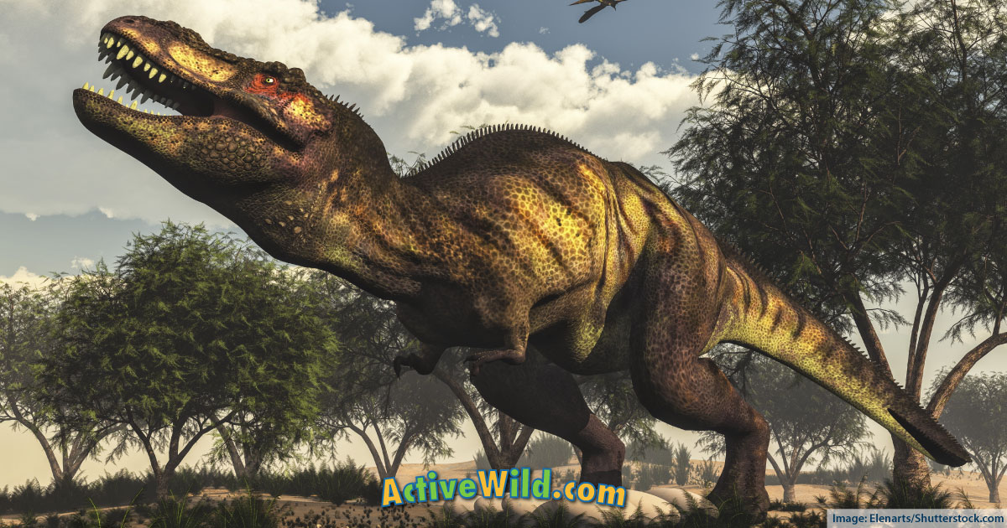
Dinosaurs
by ISLa Gaffney

Slide 2
Some dinosaurs had scales, claws and tails.

Slide 3
The pterodactyl has a silent p. The pterodactyl flew in the sky.

Slide 4
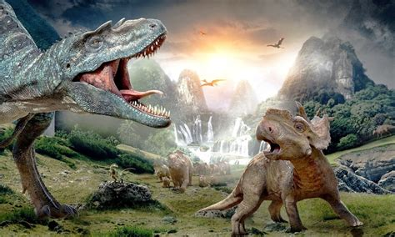
Dinosaurs laid eggs.

