Slide 1
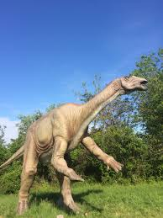
dinosaurs
By Jessica

Slide 2
dinosaurs were all different.
THE T REX WAS BIG.
BRACHIOSAURUS HAD A LONG NECK.

