Slide 1
DINOSAURS By Katie-rose

Slide 2
SOME DINOSAURS WERE CARNIVORES AND SOME WERE HERBIVORES.
A T-REX HAD SHORT ARMS AND A LONG NECK.

Slide 3
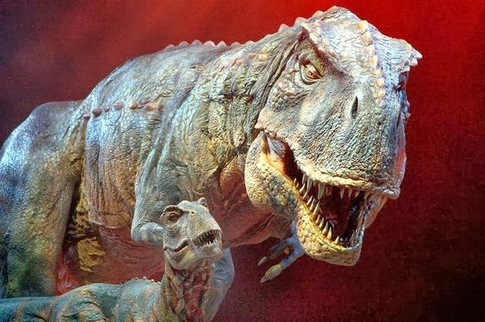
THE DInoSARUS ARE NOW EXTINCT.

