Slide 1
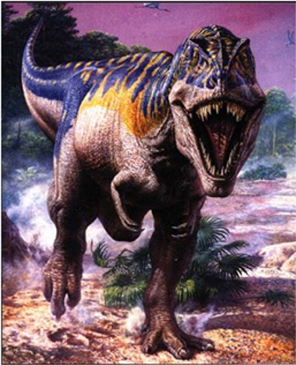
What I know about dinosaurs?
By Maisie

Slide 2
Dinosaurs were all different shapes and sizes.

Slide 3
A t-rex had big claws.

