Slide 1
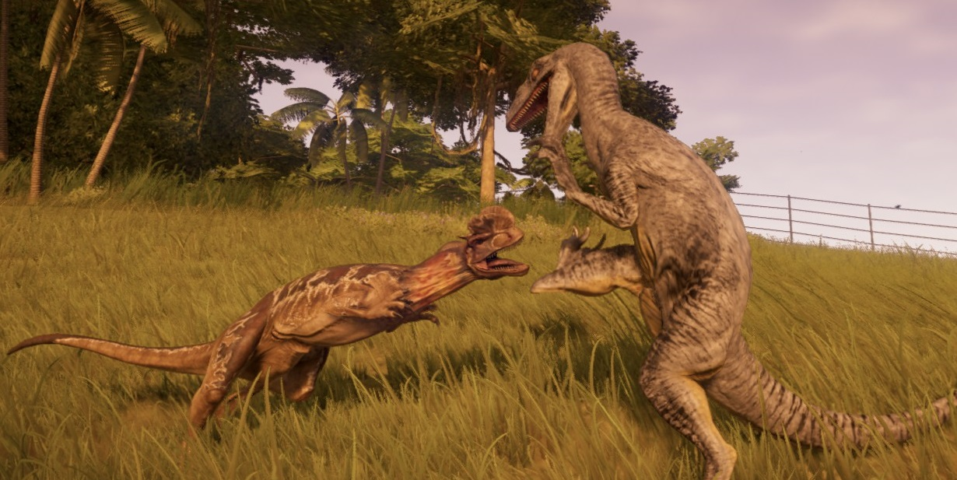
Dinosaurs by megan

Slide 2
Dinosaurs were all different shapes and sizes.
A t-rex had short arms and a long tail.

Slide 3
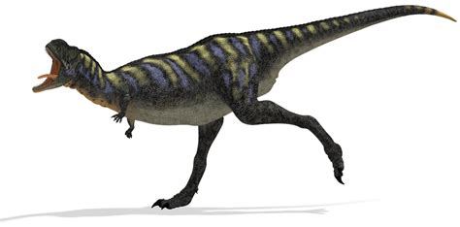
Dinosaurs were different colours.

