Slide 1
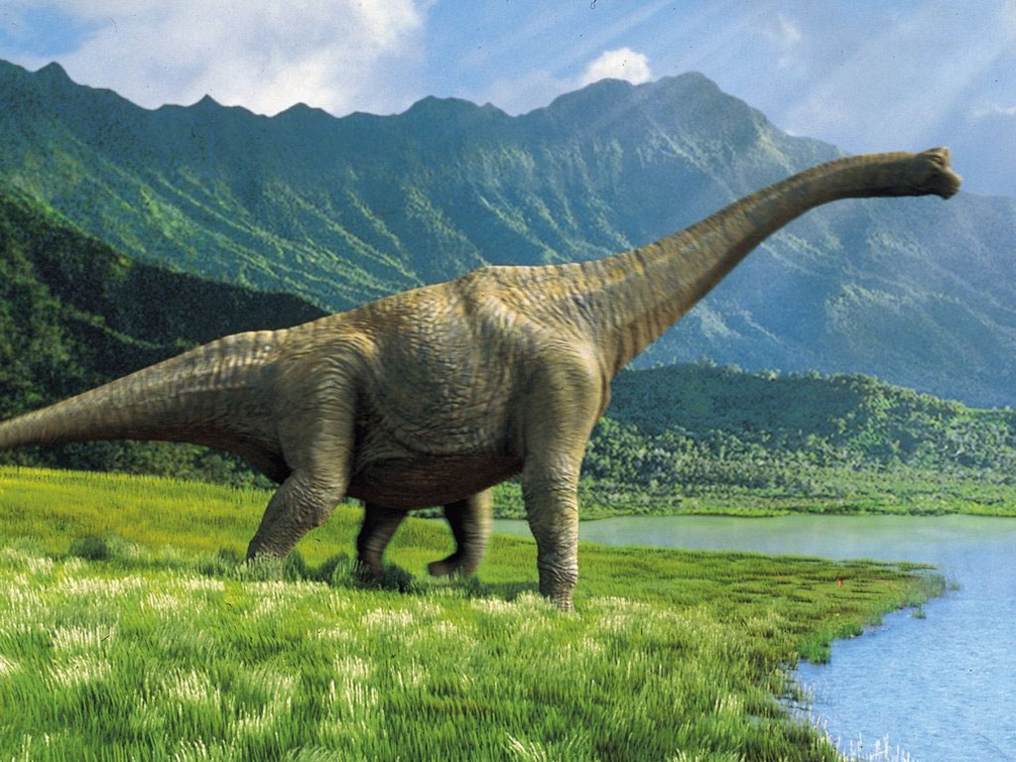
Dinosaurs
By Molly-Rose

Slide 2
The T-Rex had a long tail and short arms.

