Slide 1
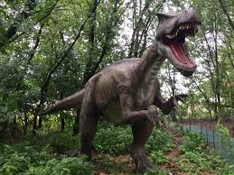
Dinosaurs
By Niamh Connolly
Primary 3

Slide 2
1.T-Rexs walked on two limbs and the other two limbs were used for hands.
2.Some dinosaurs were meat eaters and some were plant eaters.
3.Dinosaurs were all shapes and sizes.

Slide 3
4.A Triceratops had three horns on its head.
5.A Pterodactyl has a silent p.
6.A Stegosaurs had bony plates on its back.

Slide 4
7. A T-Rex had short arms.
8. T-Rex could run very fast.

Slide 5
9. There was a chicken sized dinosaur called compsognathus.
10.Dinosaurs all laid eggs.

Slide 6
11.Some dinosaurs were carnivores.
12.Brachiosauruses had a very long neck and a very long tail.

Slide 7
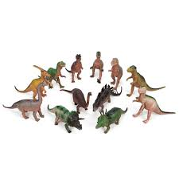
13.Dinosaurs had very sharp teeth.

