Slide 1
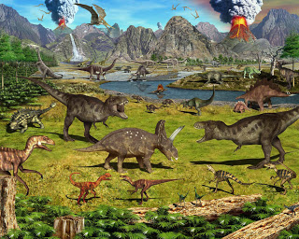
What I know about Dinosaurs By Oisin

Slide 2
Dinosaurs were all different shapes and sizes.

Slide 3
The T-Rex had a long tail .

