Slide 1
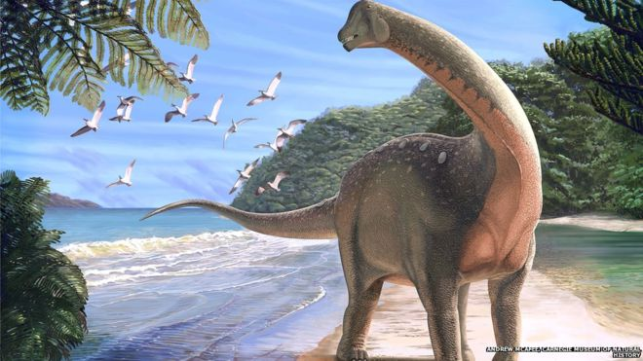
Dinosaurs By Portia

Slide 2
Some dinosaurs were meat and plant eaters.

