Slide 1
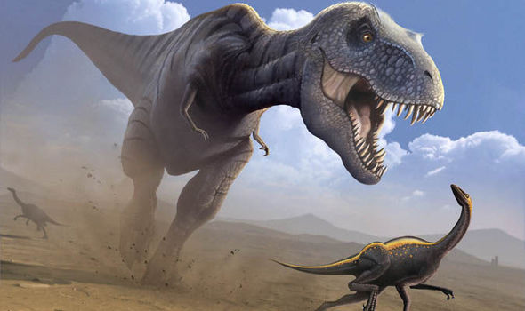
Dinosaurs
By Rosie Watters

Slide 2
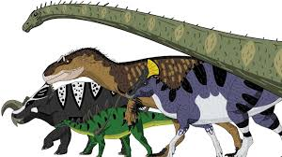
Dinosaurs BY Rosie The T-Rex had a long tail and short arms. Dinosaurs laid eggs. Dinosaurs laid eggs. The T-Rex had a long tail and short arms.
Di

Slide 3
Some dinosaurs ate meat. Dinosaurs had sharp teeth.

