Slide 1
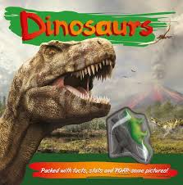
DINOSAURS
BY RYAN

Slide 2
T-Rex had a long tail and short arms.

Slide 3
A brachiosaurus had a long neck.

Slide 4
All dinosaurs had different names.

