Slide 1
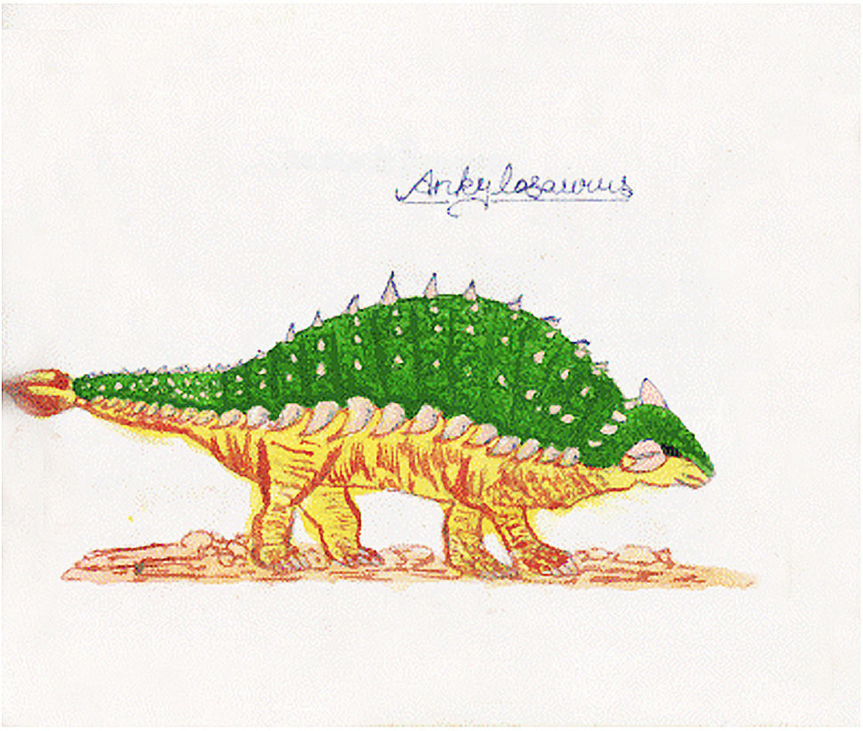
dinosaur facts
By Shay Garvey

Slide 2
T - rex
The T – Rex had short arms.
The T-Rex was one of the biggest dinosaurs on earth.

Slide 3
Some dinosaurs had big teeth.
Some dinosaurs were carnivores and some were herbivores.
Some dinosaurs were very big and some were small.

Slide 4
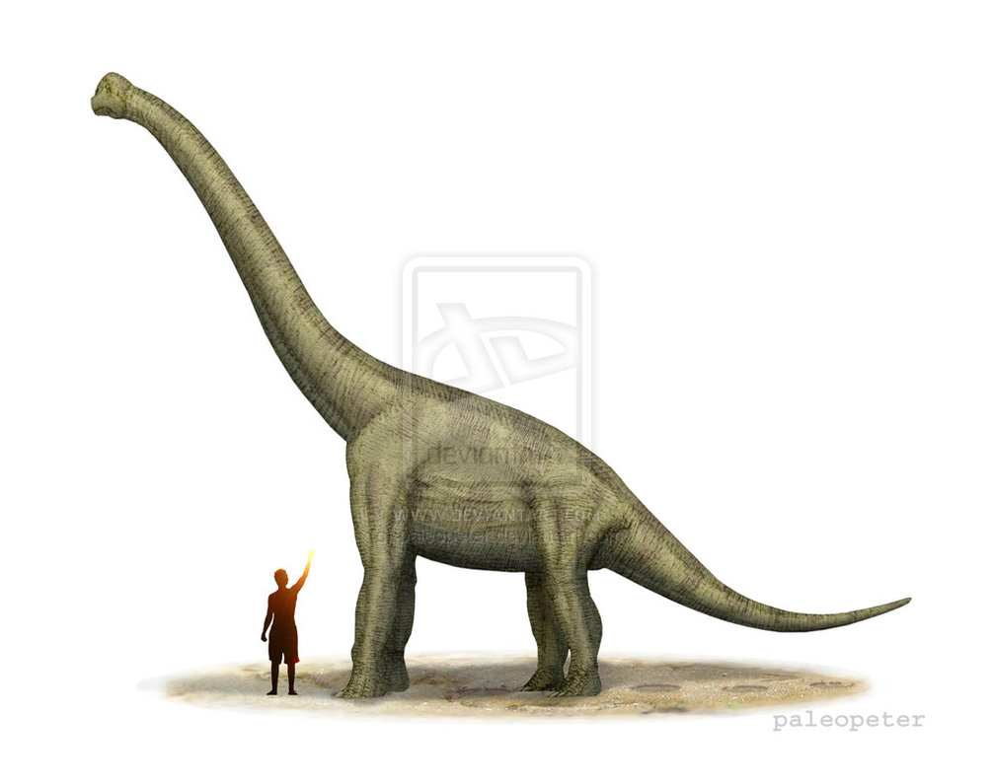
A Brachiosaurus had a very long neck.

