Slide 1
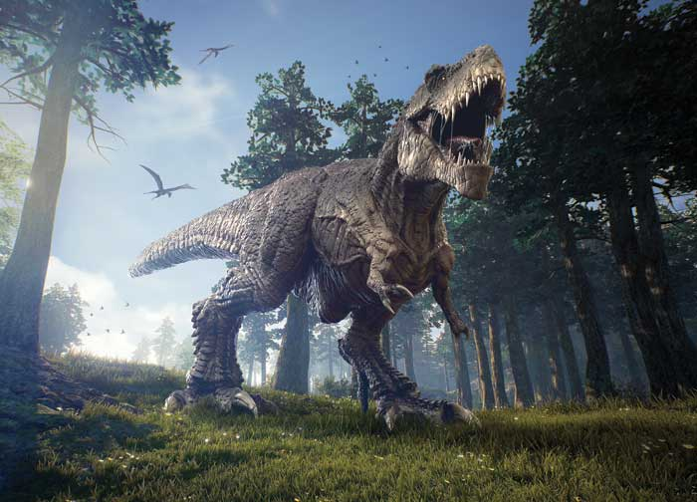
Dinosaurs by Tom

Slide 2
Dinosaurs had sharp teeth.
A T-Rex was big.
Some dinosaurs ate meat and some ate plants.

