Slide 1
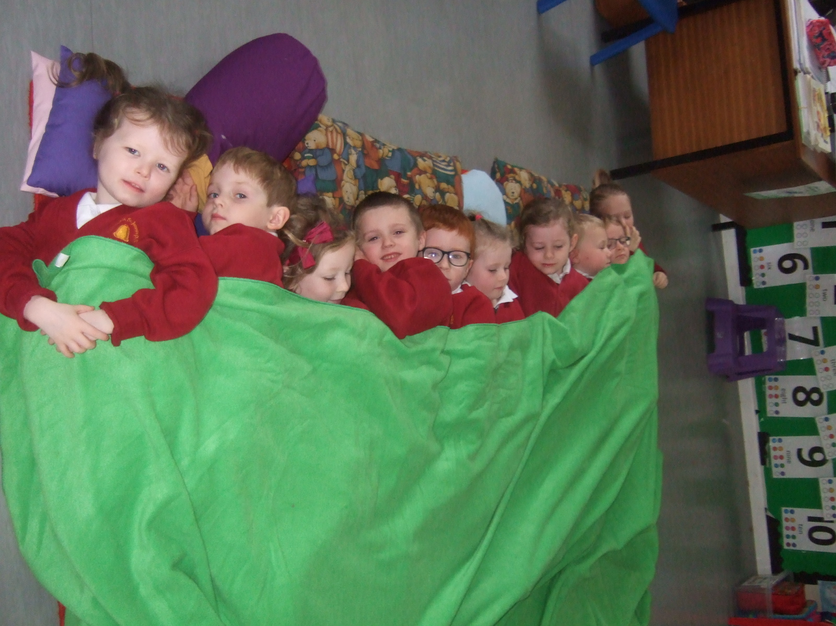
Ten in the bed!
By Primary 1

Slide 2
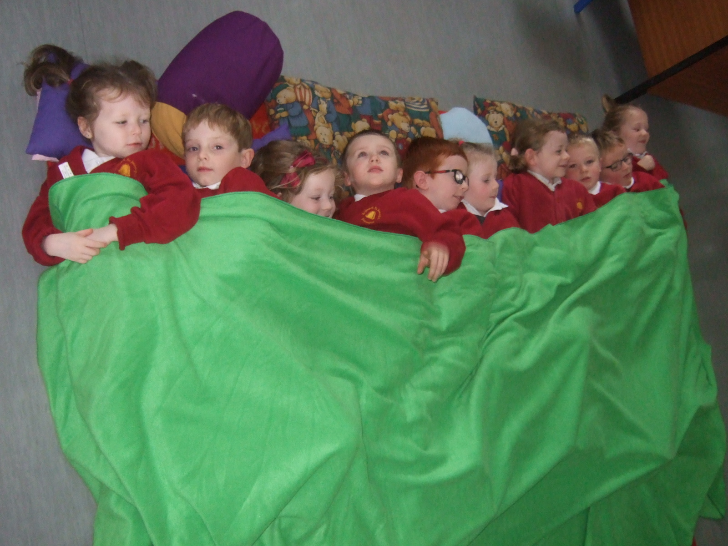
There were 10 in the bed and the little 1 said, “Roll over, roll over!” So they all rolled over and 1 fell out! Bump!
10

Slide 3
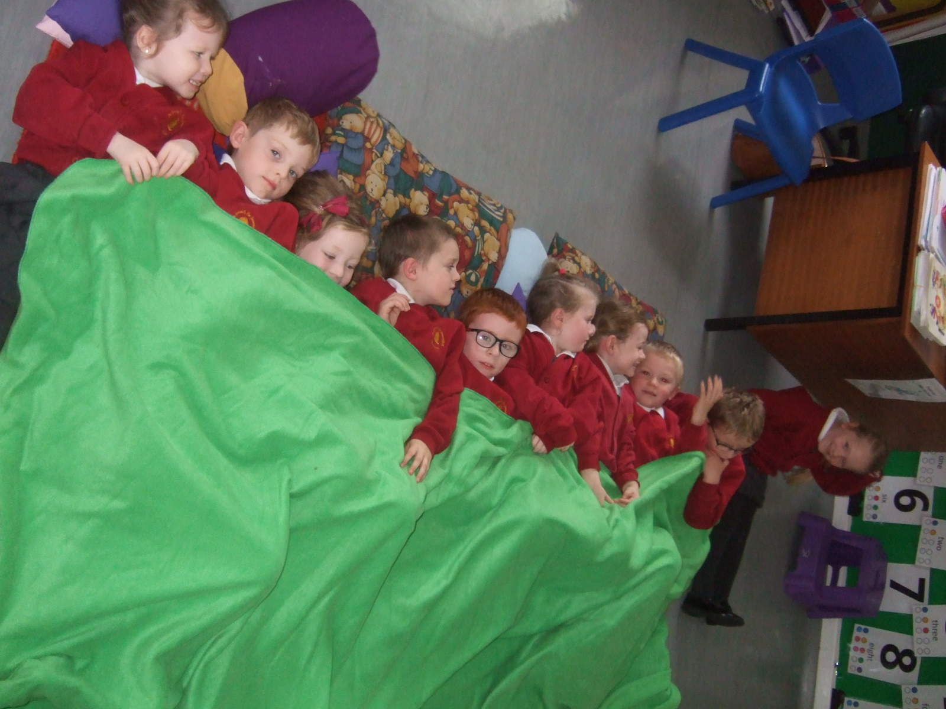
There were 9 in the bed and the little 1 said, “Roll over, roll over!” So they all rolled over and 1 fell out! Bump!
9

Slide 4
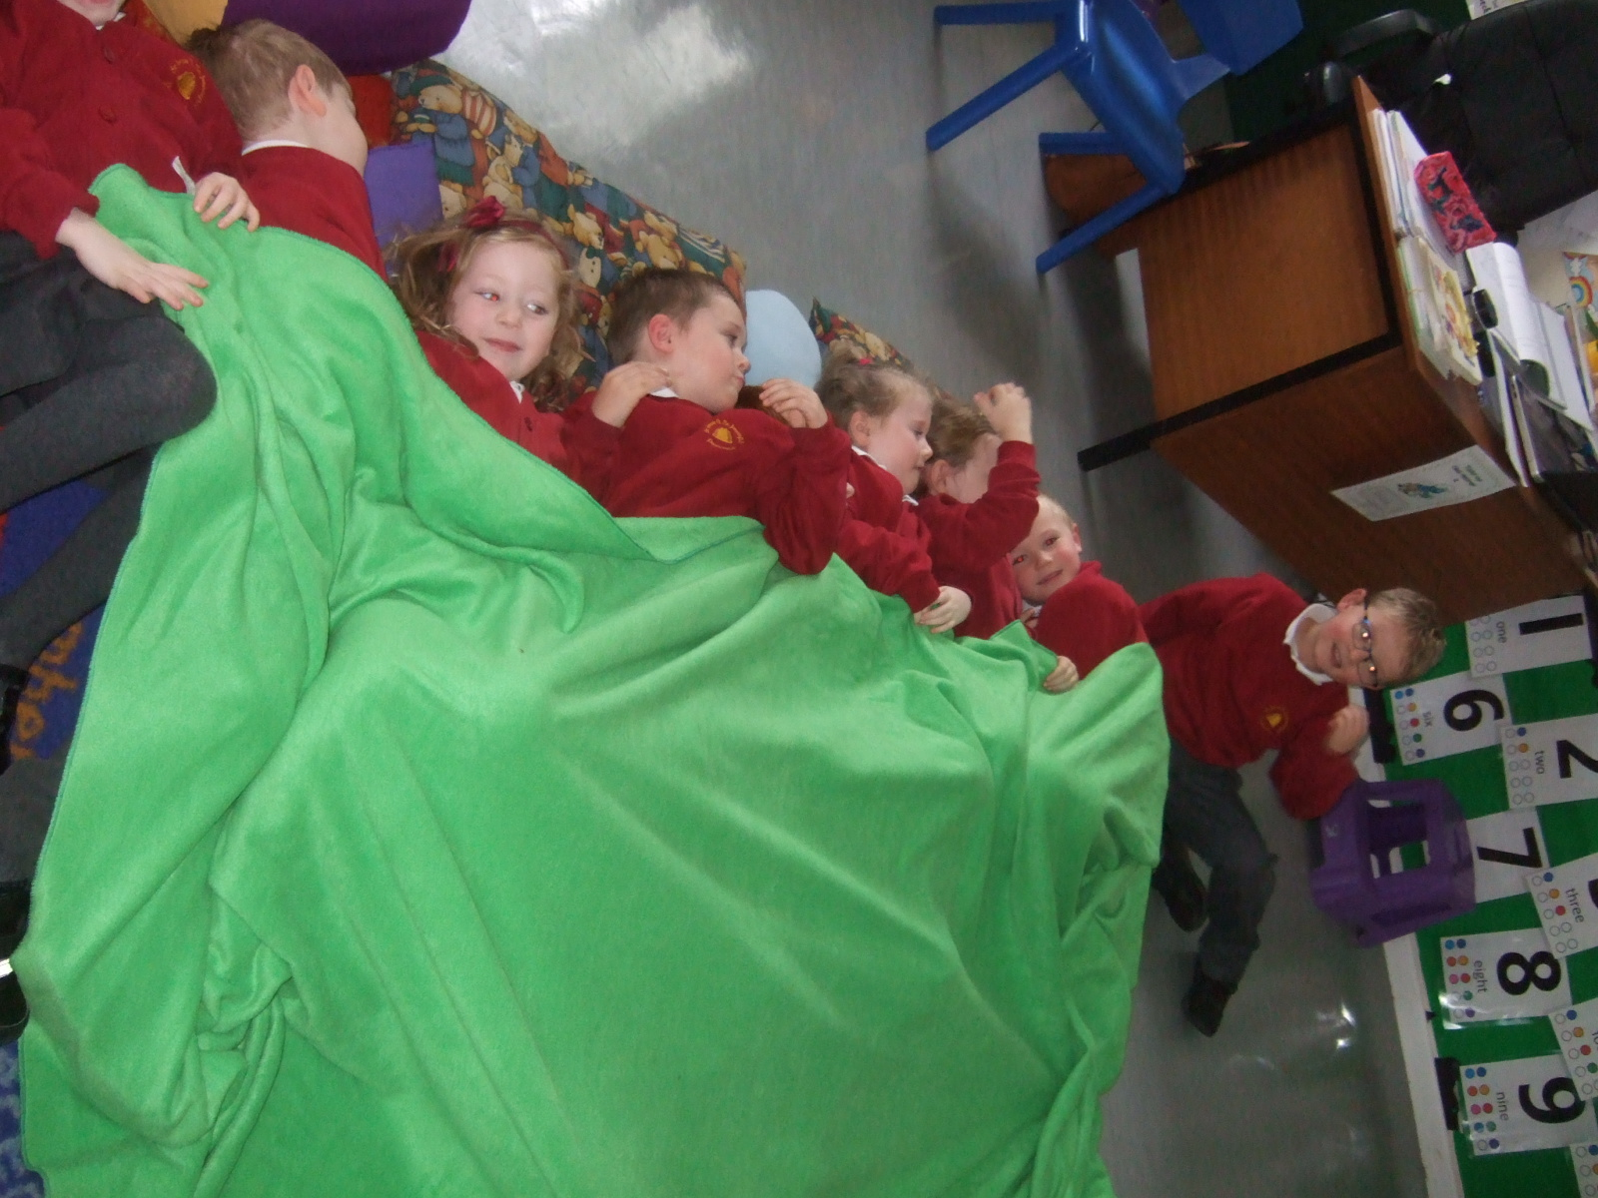
8
There were 8 in the bed and the little 1 said, “Roll over, roll over!” So they all rolled over and 1 fell out! Bump!

Slide 5
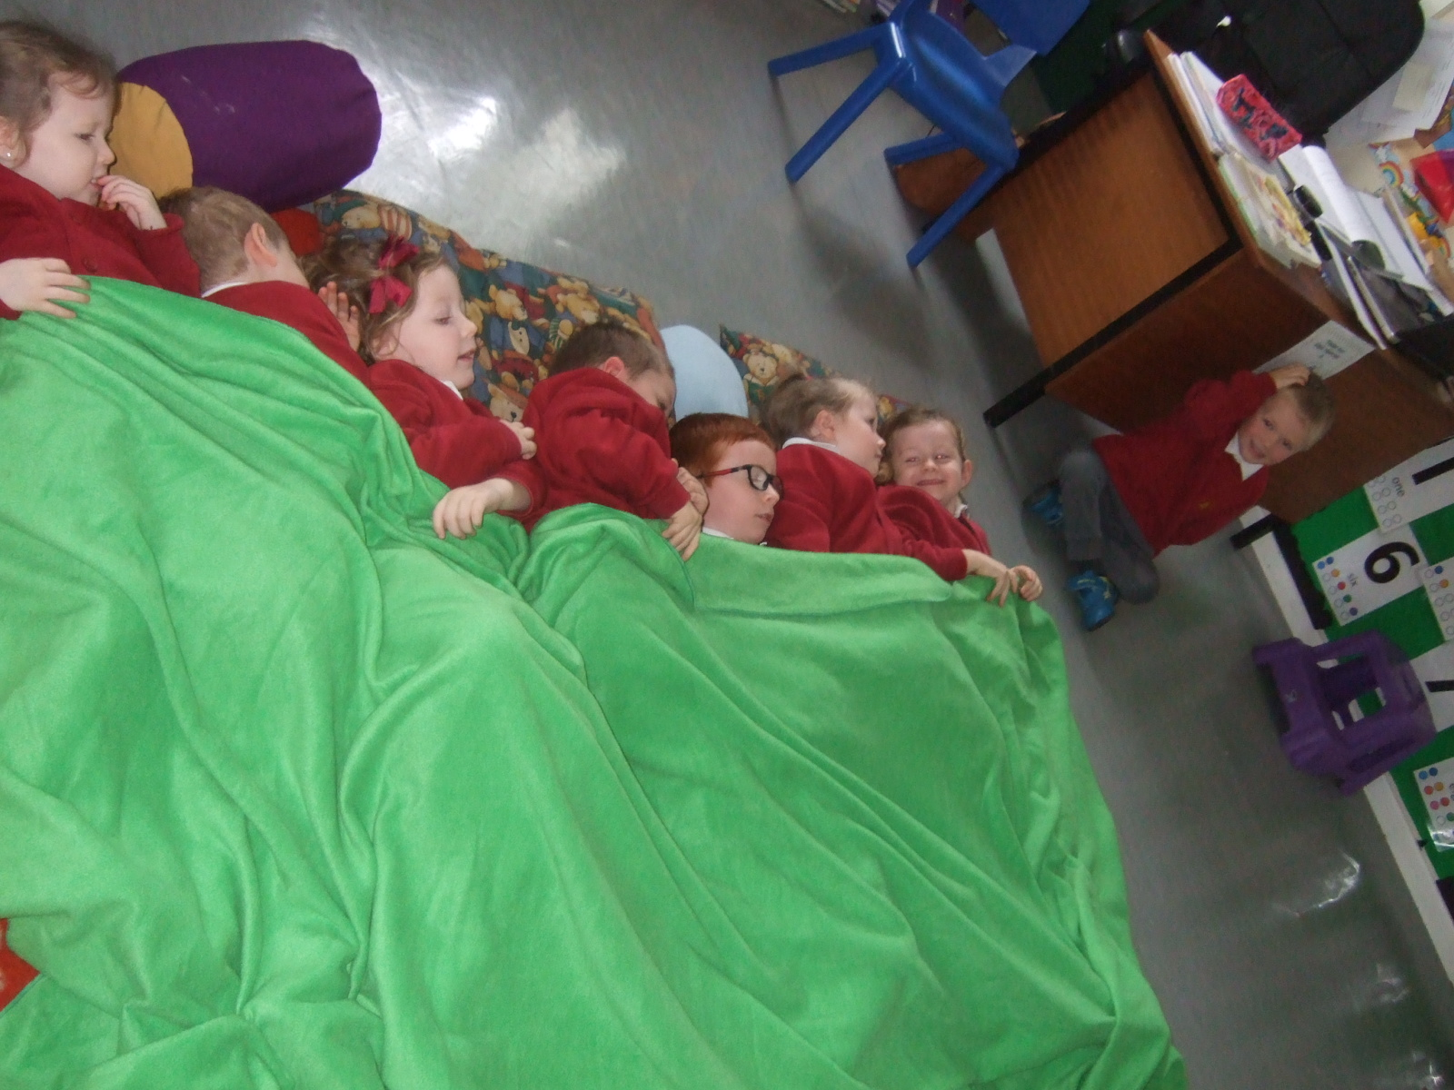
7
There were 7 in the bed and the little 1 said, “Roll over, roll over!” So they all rolled over and 1 fell out! Bump!

Slide 6
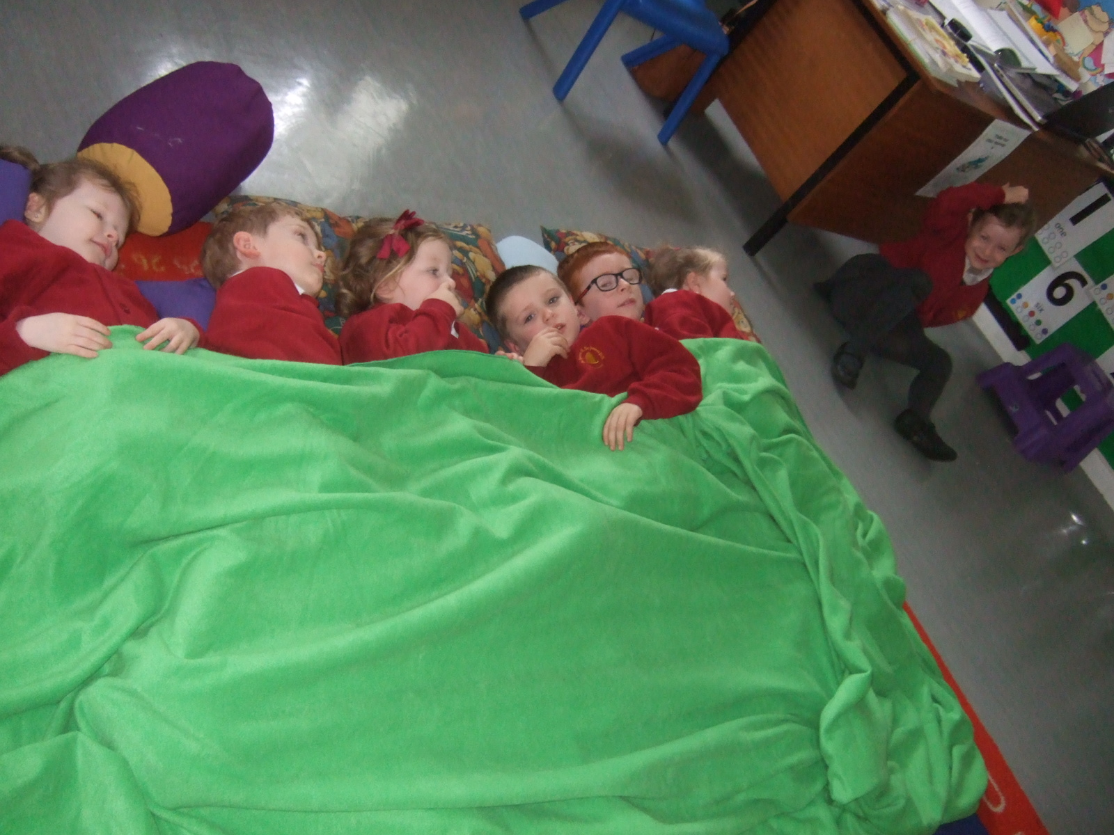
6
There were 6 in the bed and the little 1 said, “Roll over, roll over!” So they all rolled over and 1 fell out! Bump!

Slide 7
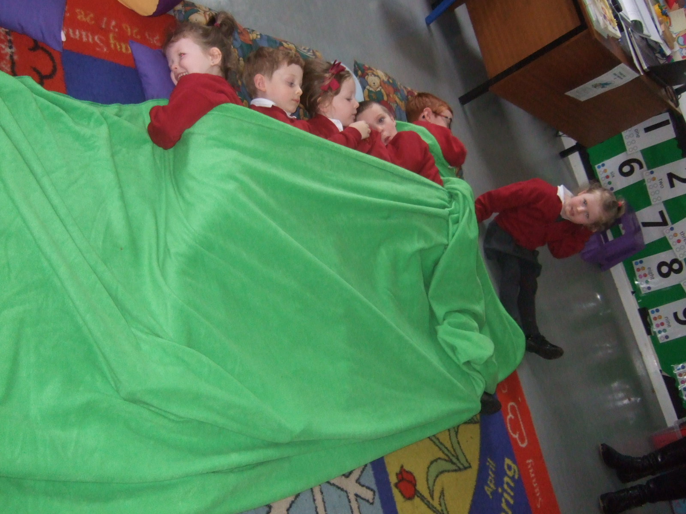
5
There were 5 in the bed and the little 1 said, “Roll over, roll over!” So they all rolled over and 1 fell out! Bump!

Slide 8
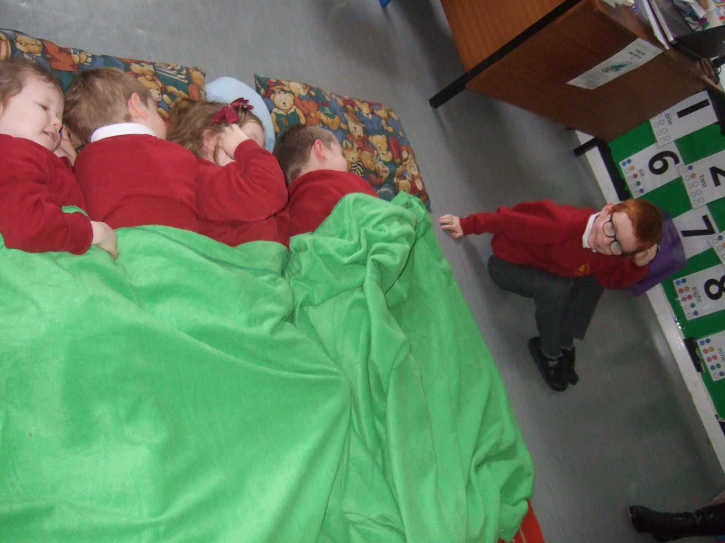
4
There were 4 in the bed and the little 1 said, “Roll over, roll over!” So they all rolled over and 1 fell out! Bump!

Slide 9
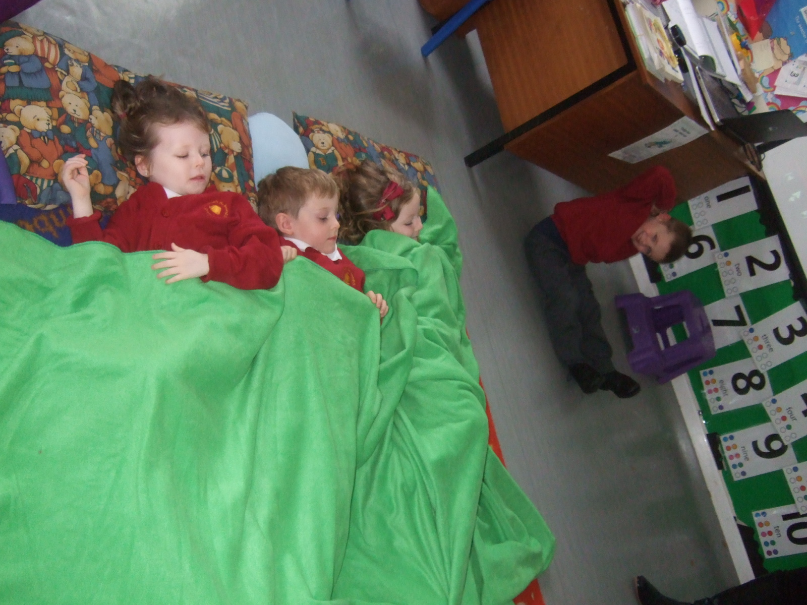
3
There were 3 in the bed and the little 1 said, “Roll over, roll over!” So they all rolled over and 1 fell out! Bump!

Slide 10
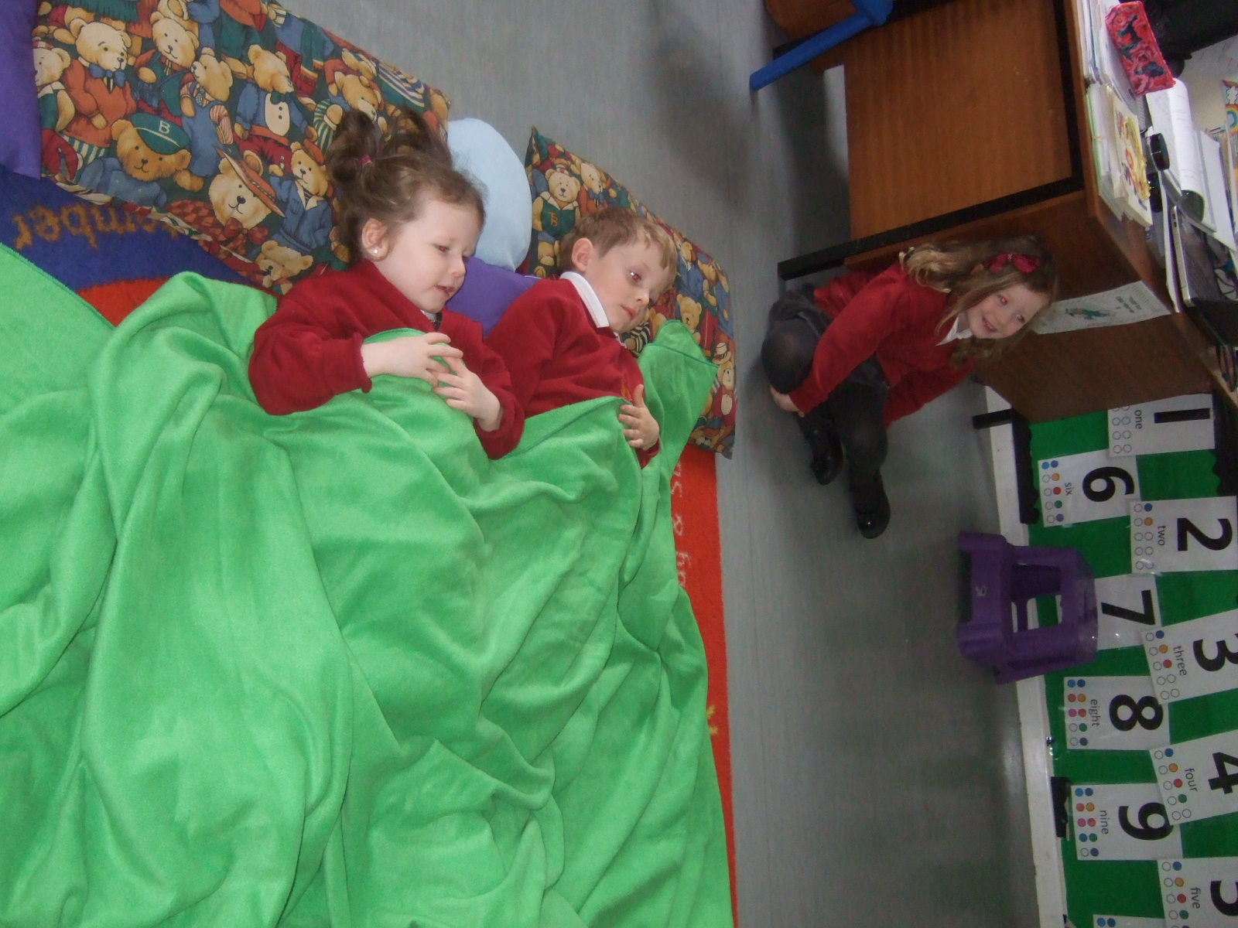
2
There were 2 in the bed and the little 1 said, “Roll over, roll over!” So they all rolled over and 1 fell out! Bump!

Slide 11
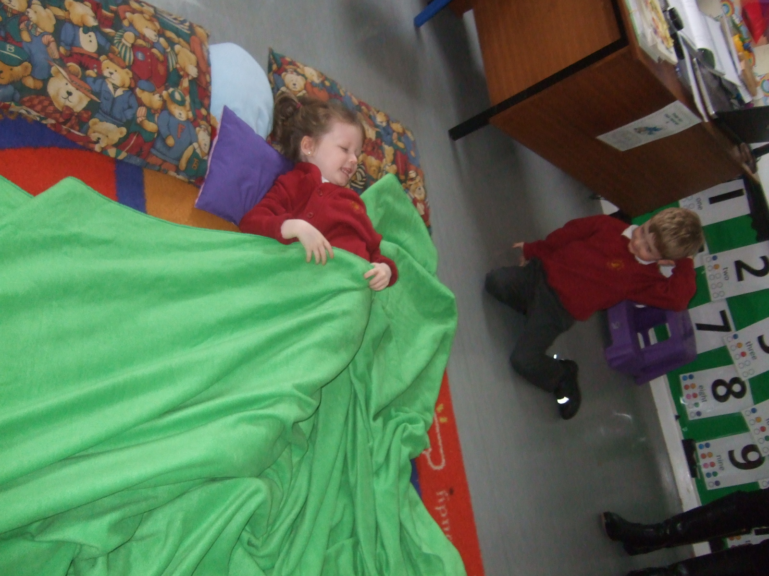
1
There was 1 in the bed and the little 1 said . . . .

Slide 12
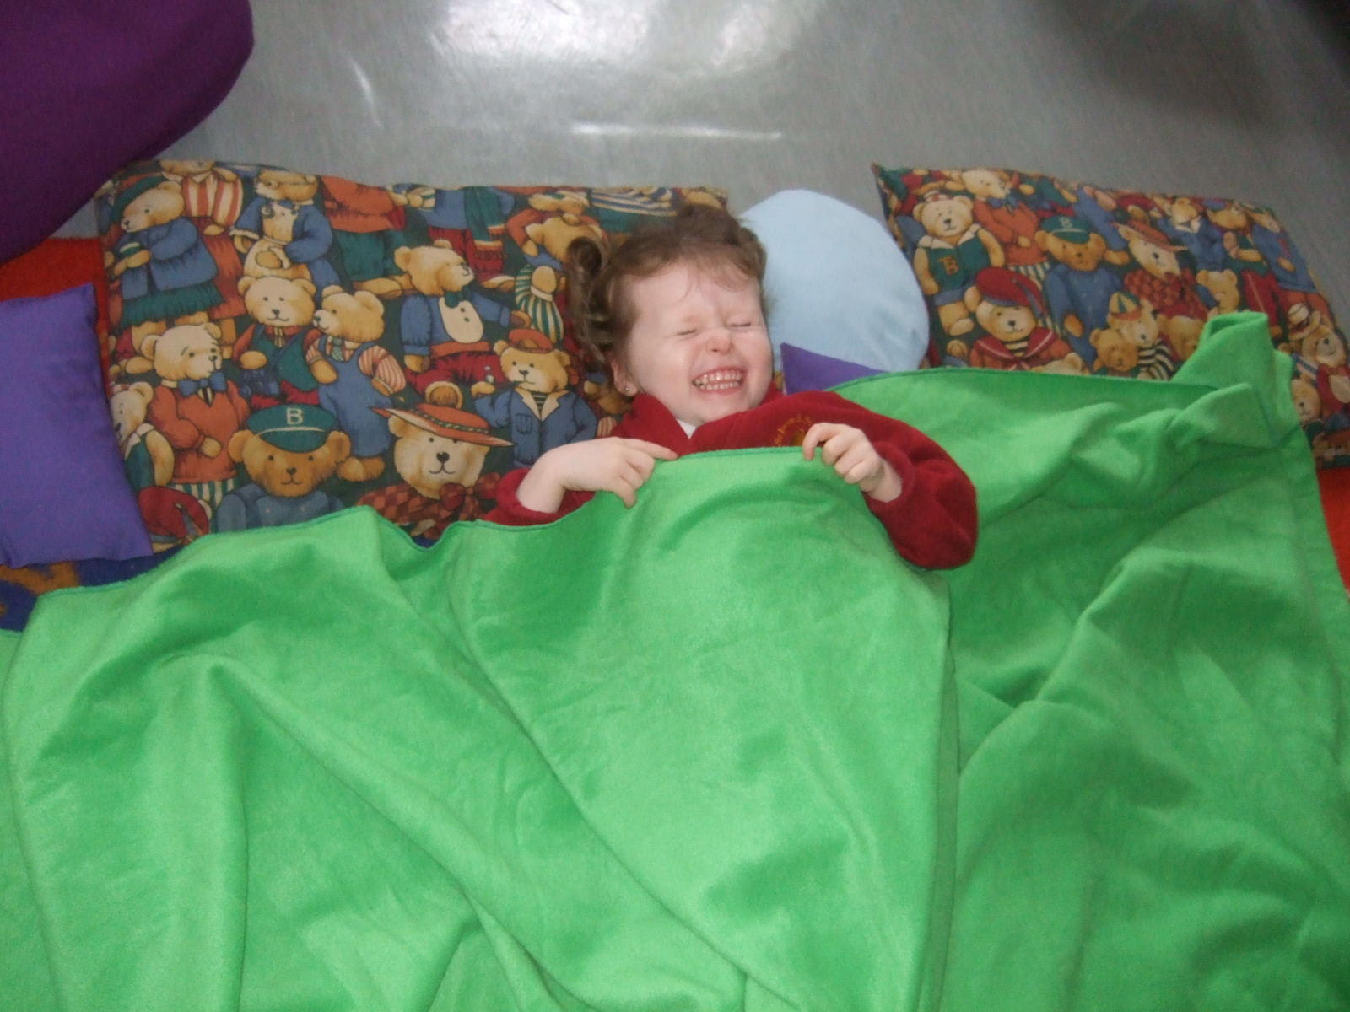
“Night, night”

